Slide 1
Advanced Matrix Quiz Review

Slide 2
A student in a school is represented by the following class.
public class Student
{
/** Returns the name of this Student. */
public String getName()
{ /* implementation not shown */ }
/** Returns the number of times this Student has missed class. */
public int getAbsenceCount()
{ /* implementation not shown */ }
// There may be instance variables, constructors, and methods that are not shown.
}

Slide 3
The class SeatingChart, shown below, uses a two-dimensional array to represent the seating arrangement of students in a classroom. The seats in the classroom are in a rectangular arrangement of rows and columns.
public class SeatingChart
{
/** seats[r][c] represents the Student in row r and column c in the classroom. */
private Student[][] seats;
public SeatingChart(List<Student> studentList, int rows, int cols)
{/* to be implemented in part (a) */ }
public int removeAbsentStudents(int allowedAbsences)
{ /* to be implemented in part (b) */ }
// There may be instance variables, constructors, and methods that are not shown.
}

Slide 4
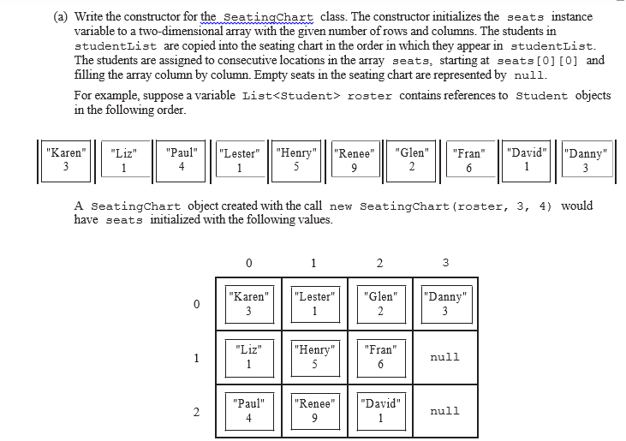
Part A

Slide 5
Part A
Complete the SeatingChart constructor below.
/** Creates a seating chart with the given number of rows and columns from the students in
* studentList. Empty seats in the seating chart are represented by null.
* @param rows the number of rows of seats in the classroom
* @param cols the number of columns of seats in the classroom
* Precondition: rows > 0; cols > 0;
* rows * cols >= studentList.size()
* Postcondition:
* - Students appear in the seating chart in the same order as they appear
* in studentList, starting at seats[0][0].
* - seats is filled column by column from studentList, followed by any
* empty seats (represented by null).
* - studentList is unchanged.
*/
public SeatingChart(List<Student> studentList, int rows, int cols)

Slide 6
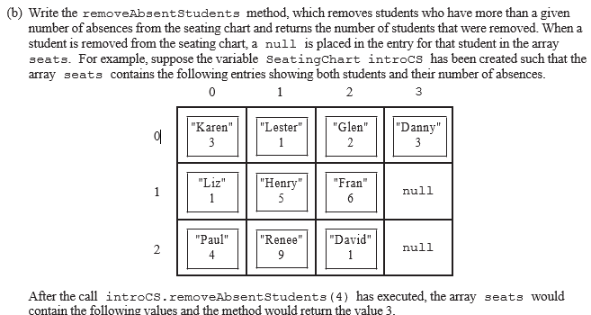
Part B

Slide 7
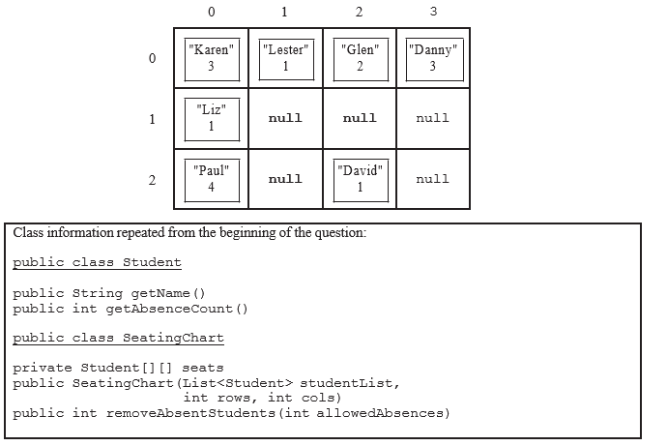
Part B

Slide 8
Complete method removeAbsentStudents below.
/** Removes students who have more than a given number of absences from the
* seating chart, replacing those entries in the seating chart with null
* and returns the number of students removed.
* @param allowedAbsences an integer >= 0
* @return number of students removed from seats
* Postcondition:
* - All students with allowedAbsences or fewer are in their original positions in seats.
* - No student in seats has more than allowedAbsences absences.
* - Entries without students contain null.
*/
public int removeAbsentStudents(int allowedAbsences)
Part B

Slide 9
SeatingChart AP Points
Part A: SeatingChart constructor 5pts
+1 seats = new Student[rows][cols]; (or equivalent code)
+1 Accesses all elements of sudentList (No bounds errors on studetnList)
+1 Accesses all necessary elements of seats array (No bounds errors on seats array, point lost if access not column-major order)
+1 Assigns value from studentList to at least one element in seats array
+1 On exit: All elements of seats have correct values (Minor loop bounds errors ok)

Slide 10
SeatingChart AP Points
Part B: removeAbsentStudents 4pts
+1 Accesses all elements of seats (No bounds errors)
+1 Calls getAbsenceCount() on Student object (Point lost if null case not handled correctly)
+1 Assigns null to all elements in seats array when absence count for occupying student > allowedAbsences (Point lost if seats array element changed in other cases)
+1 Computes and returns correct number of students removed
Question-Specific Penalties
-2 Consistently uses incorrect array name instead of seats/studentList

Slide 11
Quiz Corrections
Corrections for Advanced Matrix Quiz will be due Friday 11/20 at the beginning of class in physical (paper) form
Corrections must include:
Old (wrong) answer with comments explaining the reasoning behind your answer
“I don’t know why I wrote that.” is NOT acceptable
New (right) answer (incorrect answers will be given no credit) with a reflection on why this answer works and what you have learned
This reflection will determine whether you get credit for the correction or not. Make sure you let me know that you understand and that you weren’t just copying the correct answers from the board.
Keep this order
Do not write all of your wrong answers and then all of your corrections, do both at once
There will be tutorials on Thursday if you need help with corrections

